Slide 1
Tree II

Slide 2
Binary Search Tree

Slide 3
Binary Search Tree
What is a binary search tree?
A data structure that is used to search efficiently
Binary tree
Each node has at most two children
Ordered tree
The order of the children of a parent is important
Two children – left child and right child
Keys
Each vertex is assigned a value called key
For a vertex, its left child has lower key value whilst the right child has higher key value

Slide 4
Binary Search Tree
Create a binary search tree using the following data (keys):
15, 7, 19, 9, 4, 2, 17, 11, 20, 18
15
7
19
4
9
17
20
2
11
18

Slide 5
Binary Search Tree
Form a binary search tree for the words mathematics, physics, geography, zoology, meteorology, geology, psychology, and chemistry (using alphabetical order).

Slide 6
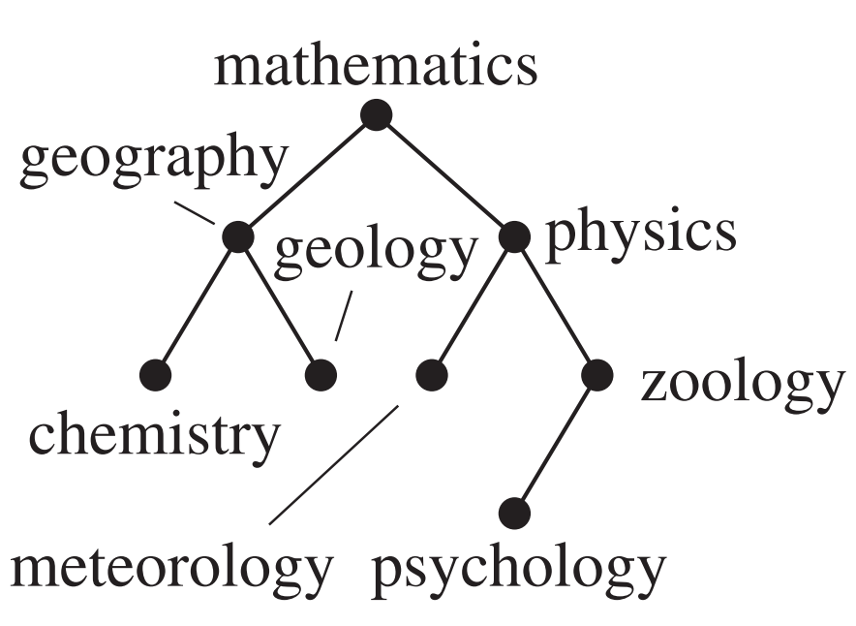
Binary Search Tree
Form a binary search tree for the words mathematics, physics, geography, zoology, meteorology, geology, psychology, and chemistry (using alphabetical order).

Slide 7
Tree Traversal

Slide 8
Tree Traversal
Tree traversal is the process of visiting and examining each node in a tree data structure, such as a binary tree, exactly once in a specific order.
There are some tree traversal methods/ standards
Pre-order: Root, Left, Right
In-order: Left, Root, Right
Post-order: Left, Right, Root
In each case –
Root = Root node
Left = Left subtree
Right = Right subtree

Slide 9
Preorder Traversal: Root, Left, Right
15
7
19
4
9
17
20
2
11
18

Slide 10
Preorder Traversal: Root, Left, Right
15,
7,
4
2,
9,
11,
19,
17,
18,
20
15
7
19
4
9
17
20
2
11
18

Slide 11
In order Traversal: Left, Root, Right
15
7
19
4
9
17
20
2
11
18

Slide 12
In order Traversal: Left, Root, Right
2,
4,
7,
9,
11,
15,
17,
18,
19,
20
← Sorted!!!
15
7
19
4
9
17
20
2
11
18

Slide 13
Post order traversal: Left, Right, Root
15
7
19
4
9
17
20
2
11
18

Slide 14
Post order traversal: Left, Right, Root
2,
4,
11,
9,
7,
18,
17,
20,
19,
15
15
7
19
4
9
17
20
2
11
18

Slide 15

Notes about tree traversal
Tree traversal algorithms are also applicable to any ordered trees, even $m$-ary trees where $m≥3$
How to achieve in order in this case?
Use the order “First child – Root – Other children”

Slide 16
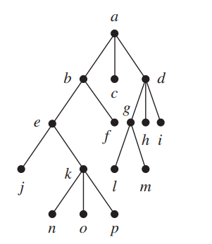
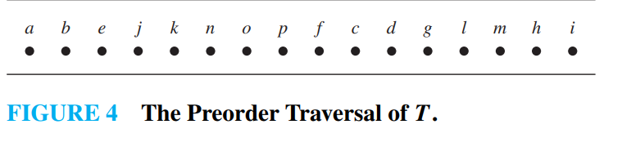
Pre-order traversal of a 3-ary tree

Slide 17
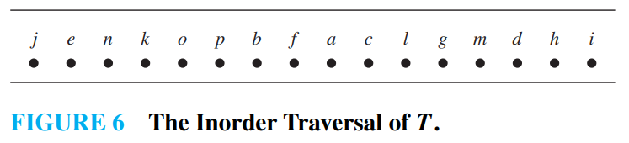
In-order traversal of a 3-ary tree

Slide 18
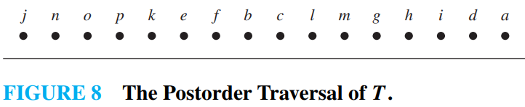
Post-order traversal of a 3-ary tree

Slide 19
Thank You

